Slide 1

Talk2Mute
Department of CSE
Jyothi Engineering College
Thrissur
June 2, 2021
Notes:
1
1
1
1
1

Slide 2
GROUP MEMBERS
Vincy Anto (JEC17CS104) Group No:25
Neethuu N (JEC17CS074)
Sidharth U (JEC17CS095)
Sreehari (JEC17CS097)
GUIDE: Ms. Sajitha I (Asst. Prof, Dept of CSE)
Project Repository Link: https://github.com/Vincy049/Group25.git
Notes:
2

Slide 3
Vision of the Department
Creating eminent and ethical leaders in the domain of Computational Sciences through quality professional education with a focus on holistic learning and excellence.
Mission of the Department
To create technically competent and ethically conscious graduates in the field of Computer Science and Engineering by encouraging holistic learning and excellence.
To prepare students for careers in Industry, Academia and the Government.
To instill Entrepreneurial Orientation and research motivation among the students of the department.
To emerge as a leader in education in the region by encouraging teaching, learning, industry and societal connect.
Notes:
3

Slide 4
INTRODUCTION
• Communication is important for every human being.
• People who are deaf & mute needs a different way to communicate to others.
• One finds it hard to interact with them without a translator.
• We are proposing a tool that converts the sign language gestures to text and speech by recognizing the gestures and displaying the corresponding word.

Slide 5
PROJECT OBJECTIVE
To make the deaf and mute interact with normal people in a more efficient way
Help people understand and learn sign language through text and audio output

Slide 6
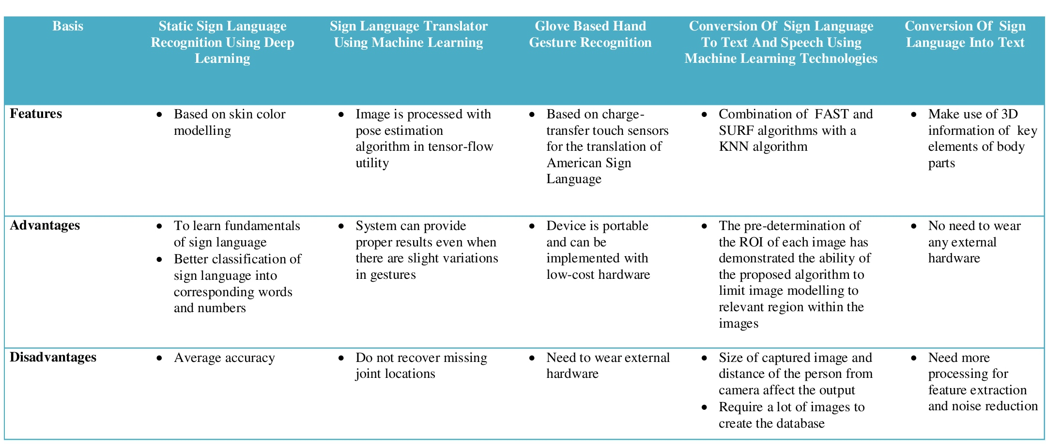
LITERATURE SURVEY

Slide 7
PROPOSED SYSTEM
Two major tasks:
To identify the sign which is shown to the web cam by the signer
To get the output in both text & audio format

Slide 8
MODULES
Data Acquisition Module
• Collection of Dataset on Sign language
Sign Identification Module
• Convolutional Neural Network is used for training
• Input images are identified as corresponding signs
• Output is displayed as text
Translation Module
• Translation of text in English to Regional language to be done

Slide 9
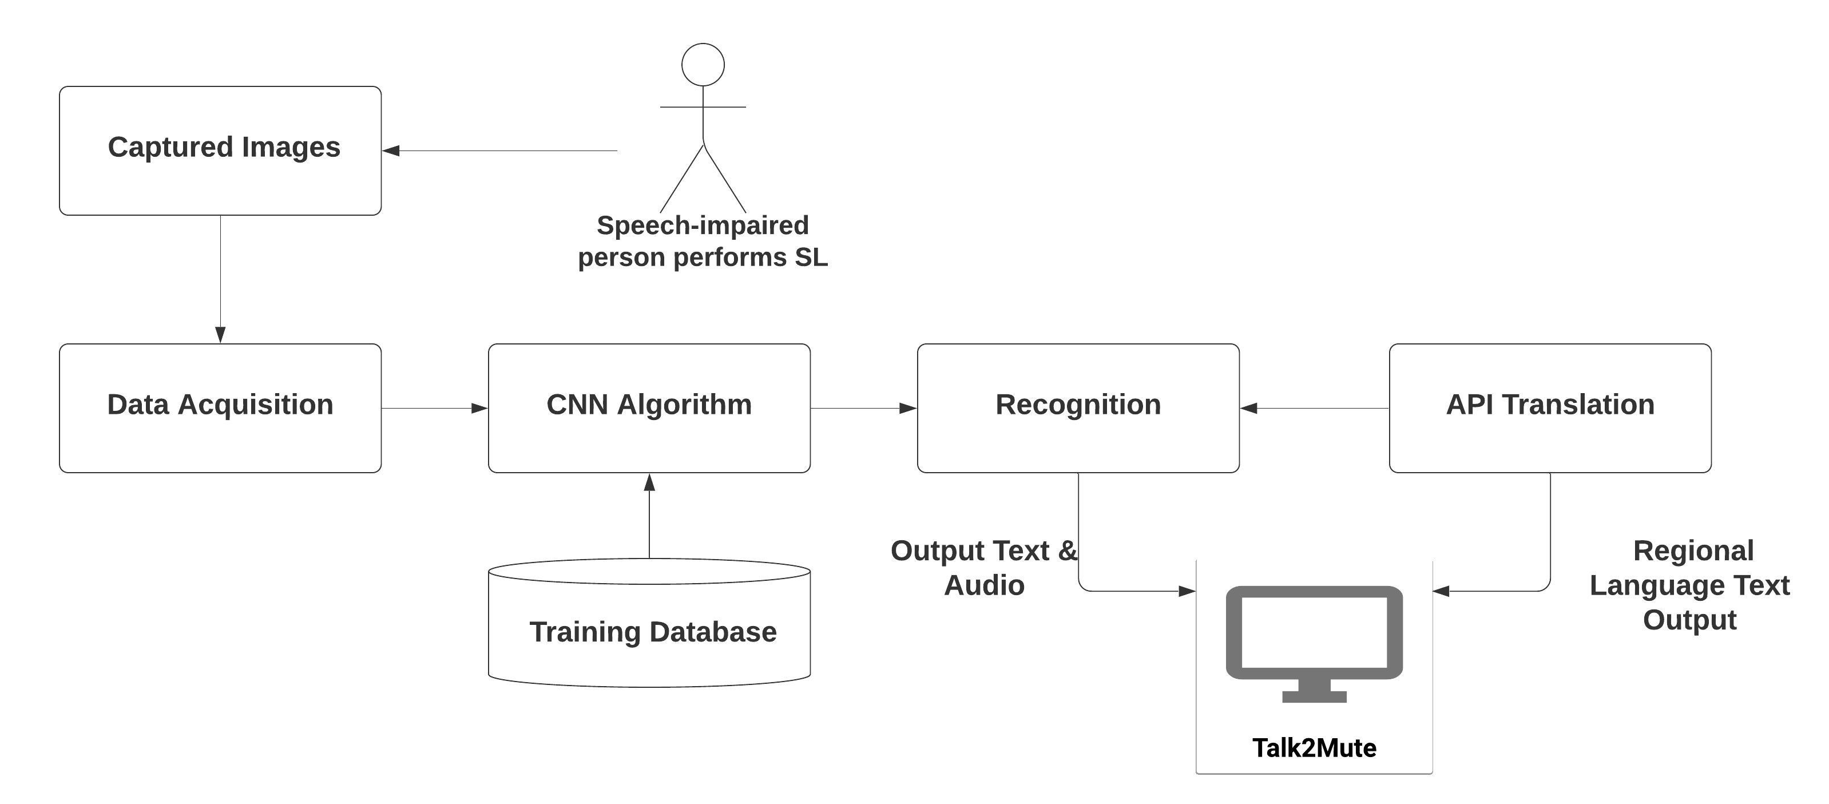
ARCHITECTURE

Slide 10
IMPLEMENTATION
The database we used contains files in .jpeg format.
All the images were resized into 200x200px.
The set of images were then divided into training and test sets with a 60:40 ratio.
For the implementation we trained our model with 67000 images from the dataset.

Slide 11
We are training our model on CNN, using the InceptionV3 architecture.
Inception model is a variation of CNN in which the layers are stacked parallel to each other which helps in reducing processing and computational cost.
The training was done by creating bottleneck.

Slide 12
A bottleneck layer is a layer that contains few nodes compared to the previous layers. It can be used to obtain a representation of the input with reduced dimensionality.
After the final training was done, we were able to get an accuracy of 89.5% for the data given.

Slide 13
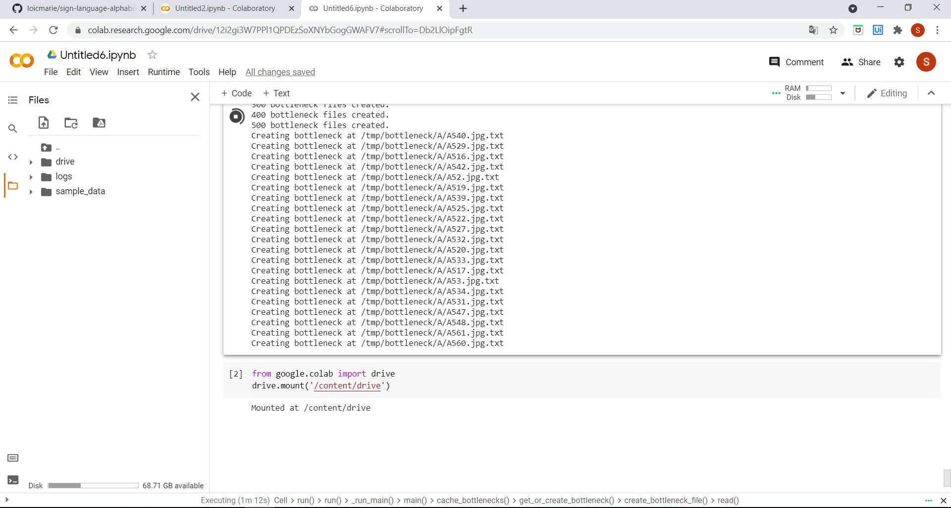
Training

Slide 14
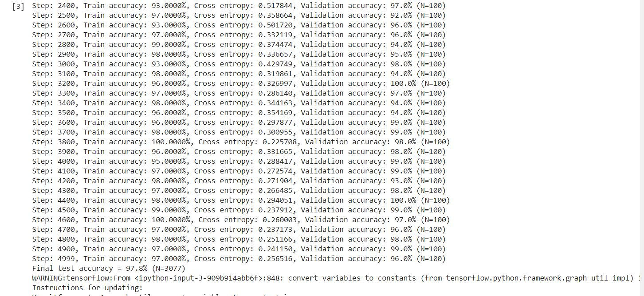

Slide 15
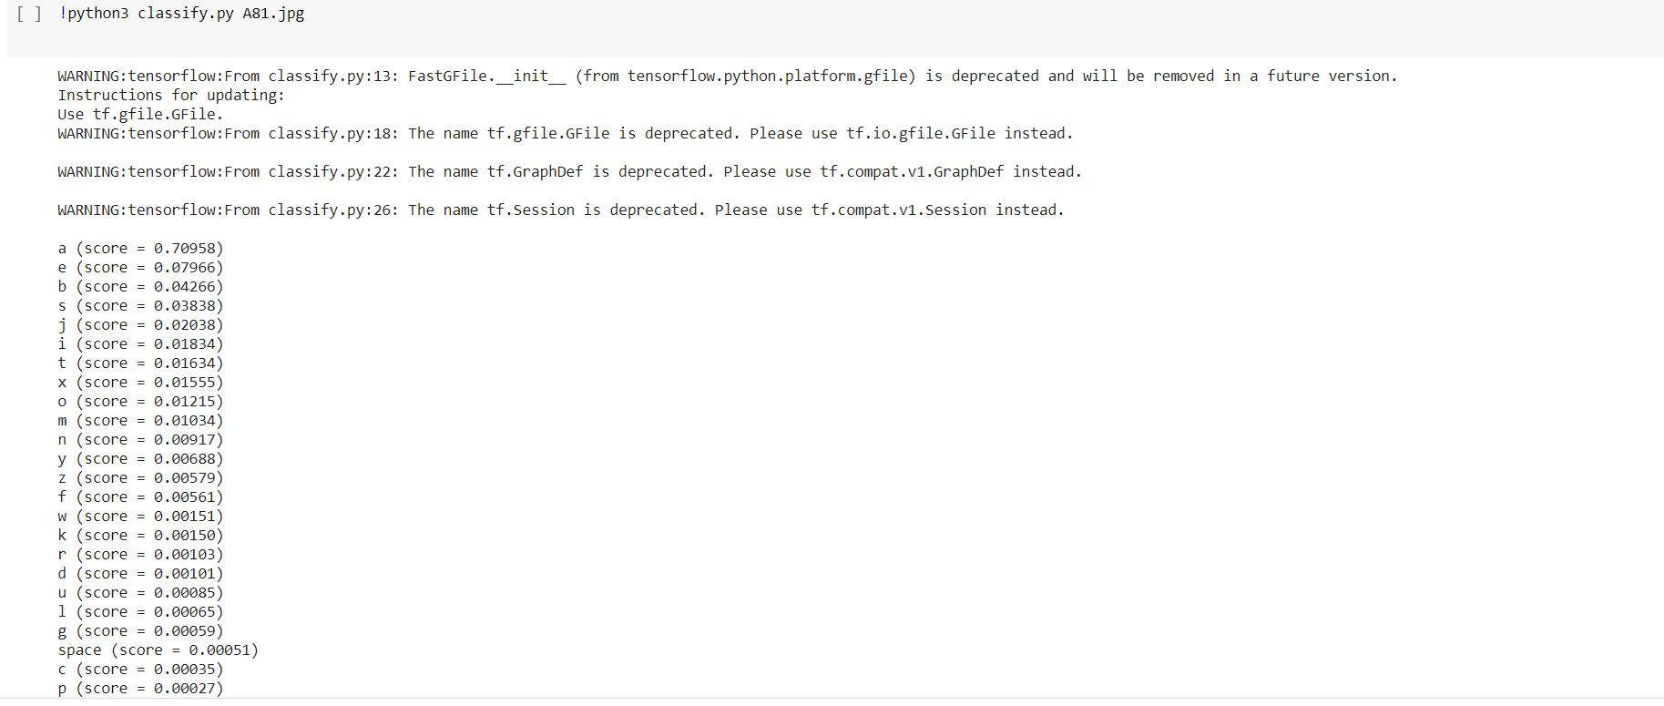
Testing

Slide 16
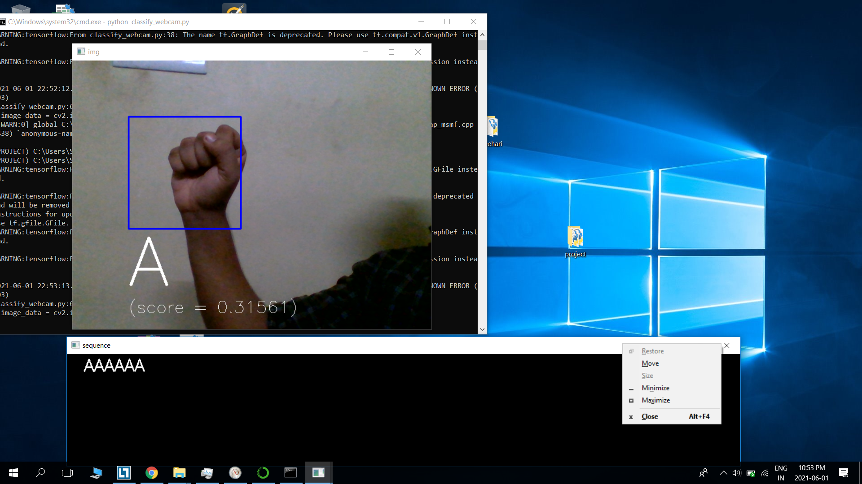
Output

Slide 17
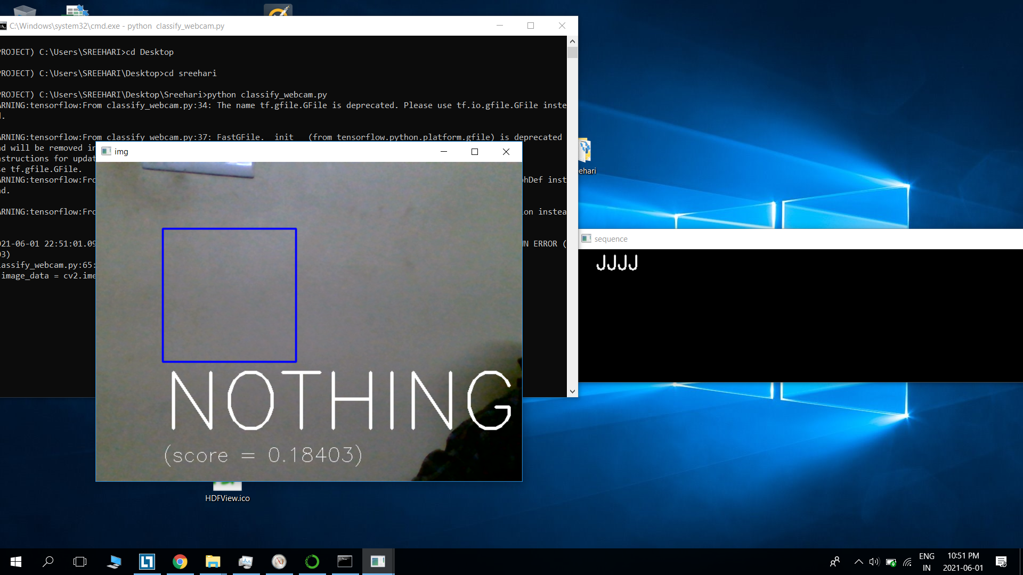
Output

Slide 18
CONCLUSION
Deaf and Dumb people rely on sign language interpreters for communication. We have proposed a system which translates Sign Language in the form of text and speech. By using CNN algorithm we were able to do this. This system makes the communication between speech-impaired people and other simple and comfortable.

Slide 19
REFERENCE
Arsan, Taner & Ulgen, Oguz. (2015). Sign Language Converter. International Journal of Computer Science & Engineering Survey. 6. 39-51. 10.5121/ijcses.2015.6403.
Mahesh Kumar. "Conversion of sign language into text." International Journal of Applied Engineering Research 13.9 (2018): 7154-7161.
Tolentino, Lean Karlo S., et al. "Static Sign Language Recognition Using Deep Learning." International Journal of Machine Learning and Computing 9.6 (2019).
Madhyastha, Srinidhi. "Conversion of Sign Language to Text and Speech." International Journal for Advance Research and Development 2.3 (2017).
K.Hemanth gupta, M.Viswajith reddy, M.kalyan Kumar Chowdary, M.Narengurusai, Dr.K Helen prabha. “Sign Language Translator Using Machine Learning.” International Journal of Applied Engineering Research 13.4 (2018)

Slide 20
THANK YOU
Notes:
20

